Slide 1

Combustion Engine-4GB10-Interim Presentation
5th of March 2021 , Teacher: Bart somers, Tutor: Harm Gilsing
Team 007: Lars van Alen, Thomas Driessen, Dolf Eck, Vito Fransen, Mats van der Heijden, Joey Janssen, Alexandra Văcaru, Mihai-Dragoş Ungureanu
Combustion Engine-4GB10-Interim Presentation-2021

Slide 2
Content
I. Introduction
II. Research
A. Thermodynamics & Engine Combustion
B. Bio-Fuels vs Normal Fuel
C. Theoretical Model– Script Assumptions
III. Experiments
A. Experimental Setup & Results
IV. Future plans
V. Question Round
B. Current Analysis

Slide 3

I. Introduction
Company Green Garden
Group 7: a team of 8 people
Honda GX200 engine
Deadline for the project 19th of March.
Notes:
A gardening company Green Garden (fictious) decided to opt for a using a greener fuel
A team of 8 people will focus on analyzing this green fuel and see how it react with the Honda GX200 engine
Deadline for the project 19th of March.
We tried to based all the research we have done on the following 2 design question:
What is the efficiency of the engine when it is running on gasoline or gasoline/ethanolblends?
How can efficiency of the engine be maximized with applying minimal changes to the engine?

Slide 4

II. Research
4
Combustion Engine-4GB10-Interim Presentation-2021

Slide 5
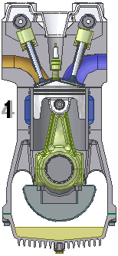
A. Thermodynamics & Engine Combustion
Otto combustion engine with carburetor
Otto cycle strokes:
Intake
Compression
Combustion
Expansion
Exhaustion
Notes:
The air-fuel mixtures comes in the combustion chamber
The mixture is compressed by the piston
Spark plug ignites the compressed mixture
Ignited mixture is then used as power (piston pushed down)
Left-over exhaust gasses are pushed out of the combustion chamber by the piston

Slide 6
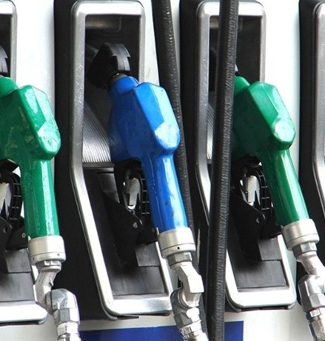
B. Bio-Fuels vs Normal Fuel
Ethanol is a bio-fuel
Gasoline is crude oil (distillation)
Fuels used: E0, E5, E10, E15
Our goal: best fuel for:
Efficiency
Emissions (C02)
Fuel Consumption
Notes:
Bio-ethanol is produced either from corn, sugar plants or starch (fermentation)

Slide 7
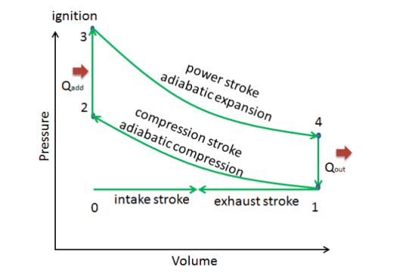
C. Theoretical Model– Script Assumptions
Adiabatic compression
Isochoric combustion
Adiabatic expansion
Exhaust/Intake isothermal/isobaric
Notes:
- Describes the corresponding changes in volume and pressure in the system
-Determine the efficiency of the engine
- Allows to make statements about the internal energy, heat transferred and worked done on a gas
- Assumptions:

Slide 8
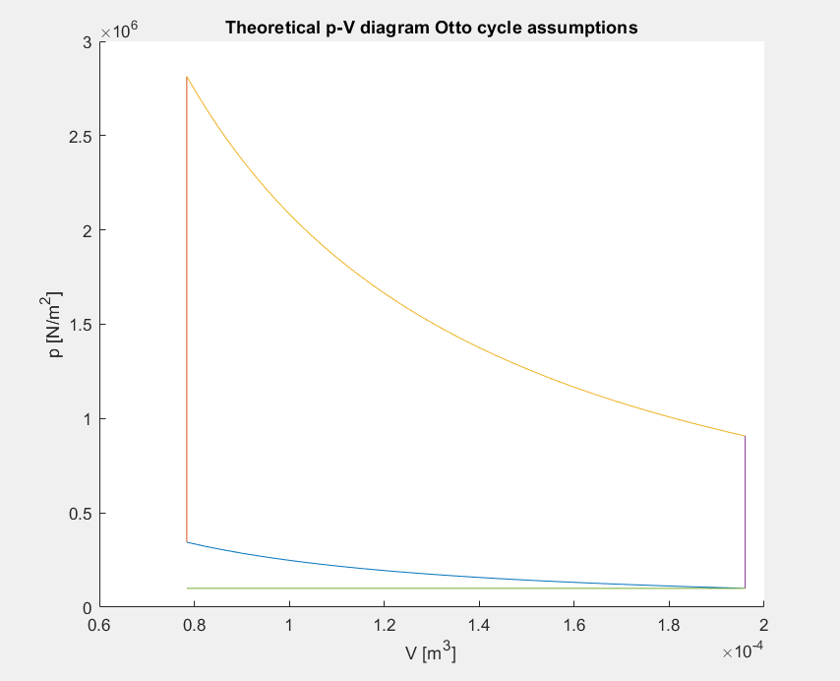
C. Theoretical Model– Script Assumptions
Stochiometric reaction
Open system
Neglect the other noble gasses in the air
Intake ambient pressure and temperature (20 °C)
Exact ethanol percentages and no heat loss
Notes:
For simplicity of our theoretical analysis the following assumptions were made while creating our Matlab script
This is the base of the real model that we are currently developing right now

Slide 9

III. Experiments
9
Combustion Engine-4GB10-Interim Presentation-2021

Slide 10
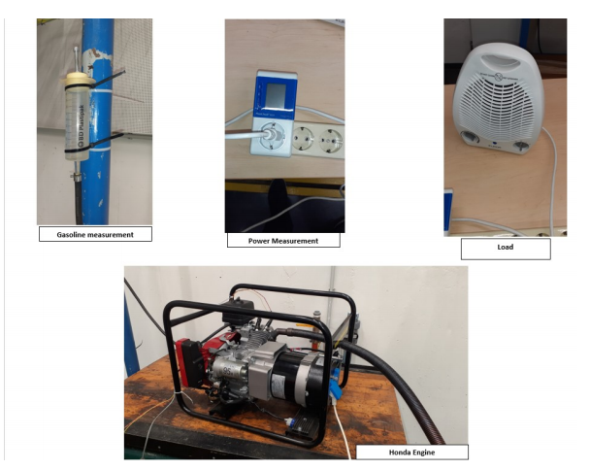
A. Experimental Setup & Results
4 fuel types: E0, E5, E10, E15
Power at different loads (no load, half-load, full-load)
Voltage
Pulse
Volume change
Notes:
2 types of gasoline were used E0 (3 runs each) and E10 (4 runs each) and 3 load scenario were conducted (no load, half-load, full-load)
2 types of gasoline were used E5 and E15 using the same load scenario, 5 times each

Slide 11
B. Current Analysis
Improving the theoretical model using measure data
Determination of the crank angle, by finding the double tooth
Calculation of engine efficiency
Notes:
Determination of the crank angle, by finding the double tooth from pressure and pulse diagrams

Slide 12
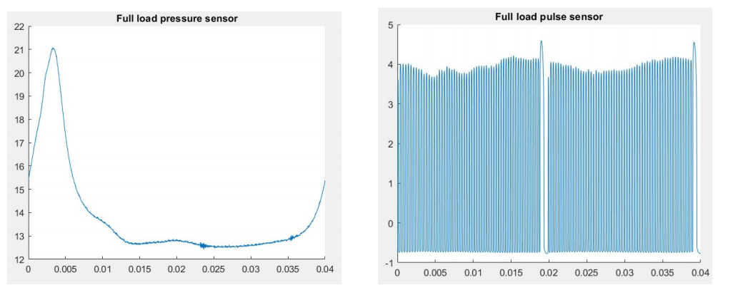
Pressure and Pulse Graphs (full load)
Notes:
To analyze and determine the phase of the engine, an examination of the pressure and pulse graph is needed
During a full cycle the crank rotates 720 degrees meaning that the double tooth passes by the pulse sensor twice in a full cycle. (0.04s )
This is the reason why in the pulse graph, the double tooth is present twice in a cycle

Slide 13
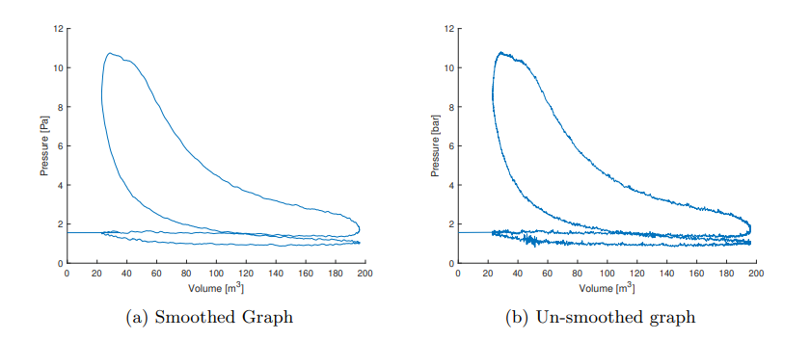
PV Diagram (half load)
Notes:
lines are not so smooth and the edges not that crisp.
What also can be noticed is the pressure below 1 atmosphere (1013 PA) in the bottom of the graph. That means that the fuel mixture is literally sucked into the cylinder compartment.
- The intake and exhaust stroke also don’t walk exact the same route, that could be very logical, but that is not the same as a theoretical model.
- All these small differences can be seen as imperfections in the model.

Slide 14

IV. Future plans
14
Combustion Engine-4GB10-Interim Presentation-2021

Slide 15
Future steps
Determine the best fuel type by comparing the measured data sets
Improve and finish the theoretical model in Matlab
Make a Well to Wheel analysis and complete the report
Notes:
We will also work on the non-ideal gas implantation in MATLAB.

Slide 16

V. Any Questions?
16
Combustion Engine-4GB10-Interim Presentation-2021

